Slide 1
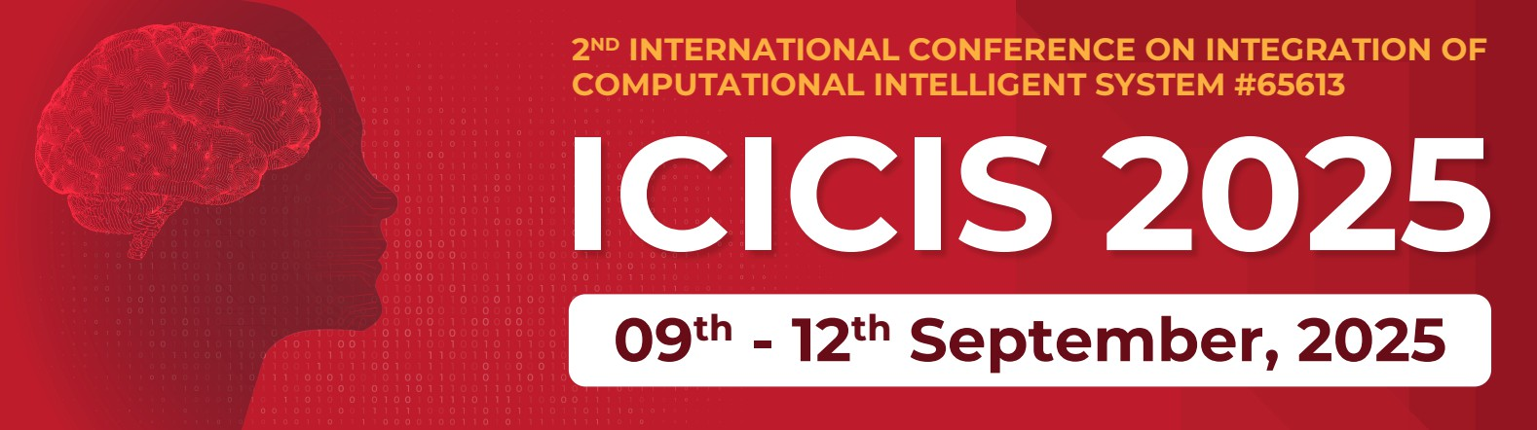



“Intelligent Traffic Signal Control System”
(570)
Arnav Sohani, Ishan Gaikwad, Omkar Lonkar, Samiksha Roy
Undergraduate Students
MIT ADT University, Loni Kalbhor, Pune, India

Slide 2


1. Introduction
Traffic congestion is a major challenge in urban cities.
As traditional traffic management systems, which rely on fixed-time traffic signals, fail to adapt to real-time changes in traffic conditions.
As cities grow and the number of vehicles increases, these systems often result in inefficient traffic flow, leading to longer travel times, increased fuel consumption, and higher levels of pollution.
02nd INTERNATIONAL CONFERENCE ON INTEGRATION OF COMPUTATIONAL INTELLIGENT SYSTEMS (ICICIS 2025)

Slide 3
2. Problem Statement
The traditional traffic light control systems often rely on fixed timers, causing delays and congestion. The limitations include:
•Fixed green light durations
•Traffic congestion
•Inflexibility
The problem addressed by this system is to provide a dynamic and intelligent traffic light control system that adjusts the light cycle based on real-time vehicle count to optimize traffic flow.
02nd INTERNATIONAL CONFERENCE ON INTEGRATION OF COMPUTATIONAL INTELLIGENT SYSTEMS (ICICIS 2025)

Slide 4
3. Concepts and Methods
Computer Vision for Traffic Detection:
YOLO v8 is used to analyze real-time camera feeds at intersections, detecting and counting vehicles from multiple directions.
Dynamic Signal Control:
The traffic signal duration is adjusted based on vehicle count, giving more green light time to busier directions, with a maximum of 60 seconds to avoid delays. Once traffic clears, the signal turns red.
Clockwise Traffic Flow:
The green light sequence follows a clockwise rotation (for example, North → East → South → West), ensuring a balanced distribution of green light time while prioritizing traffic density.
Multi-Model Fusion
Standard Vehicles: YOLO v8 (COCO classes: car, bus, truck)
Emergency Vehicles: Custom-trained YOLO v8 (ambulance, police, fire truck)
Indian Vehicles: Custom-trained YOLO v8 (auto-rickshaw, e-rickshaw)
Emergency Vehicle Detection:
Detects emergency vehicle by identifying red-blue siren light
02nd INTERNATIONAL CONFERENCE ON INTEGRATION OF COMPUTATIONAL INTELLIGENT SYSTEMS (ICICIS 2025)

Slide 5
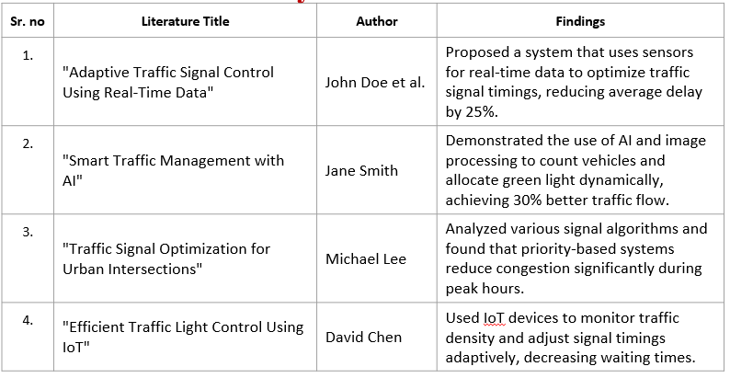
4. A) Literature Survey
02nd INTERNATIONAL CONFERENCE ON INTEGRATION OF COMPUTATIONAL INTELLIGENT SYSTEMS (ICICIS 2025)

Slide 6
4. B) Identification of gaps & scope of work
Identification of Gaps:
Lack of Real-Time Vision-Based Control
Fixed Signal Timings
Fair Distribution of Green Time
Scope of Work
Implement a real-time vehicle count detection system using cameras.
Develop dynamic traffic signal control based on counts.
Test and evaluate the system on a simulated intersection.
02nd INTERNATIONAL CONFERENCE ON INTEGRATION OF COMPUTATIONAL INTELLIGENT SYSTEMS (ICICIS 2025)

Slide 7
5. Tools and Language
Python:Primary language used to implement the logic for the traffic control system.
Libraries used for computer vision and real-time processing:
NumPy: For handling any data processing (e.g., storing vehicle counts, time calculations).
YOLO v8 (Ultralytics): Lightweight yet accurate object detection
TensorRT: Optimizes Model for 5x faster inference.
02nd INTERNATIONAL CONFERENCE ON INTEGRATION OF COMPUTATIONAL INTELLIGENT SYSTEMS (ICICIS 2025)

Slide 8
6. Process and Architecture
Input: Cameras capture live video from each direction (for example; N, S, E, W).
Detection: YOLO v8 processes frames to detect and count vehicles in each lane.
Decision Making: Direction with the lowest vehicle count gets green signal.
Timing Rules: Green light is max 60 sec, min 5 sec per direction.
Signal Rotation: If traffic clears early, signal shifts clockwise to next direction.
Cycle Reset: After serving each directions, vehicle counts are reset for that direction.
Goal: Real-time, efficient, and adaptive traffic flow management.
02nd INTERNATIONAL CONFERENCE ON INTEGRATION OF COMPUTATIONAL INTELLIGENT SYSTEMS (ICICIS 2025)

Slide 9
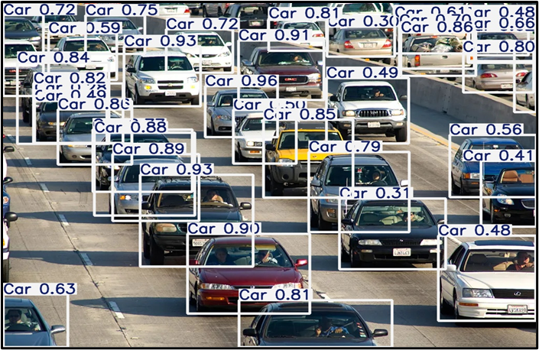
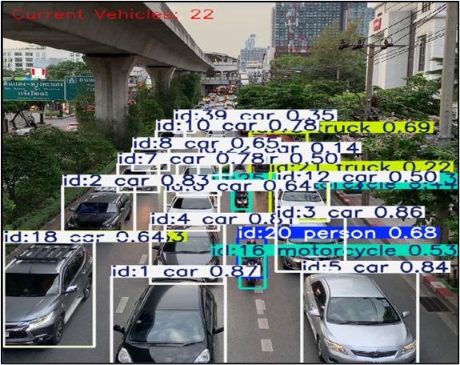
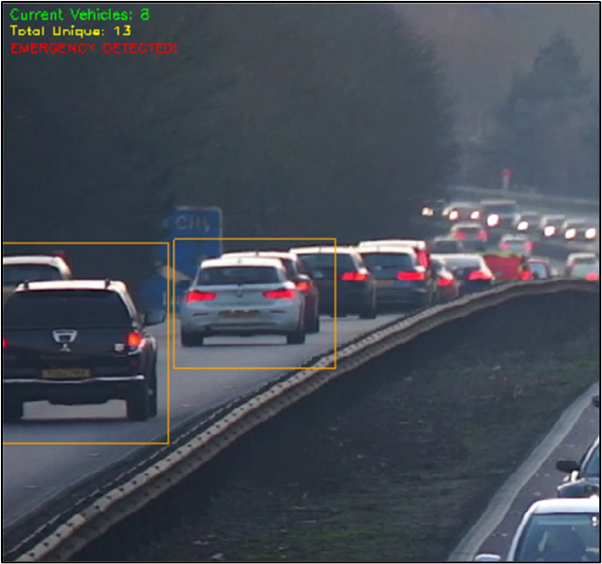
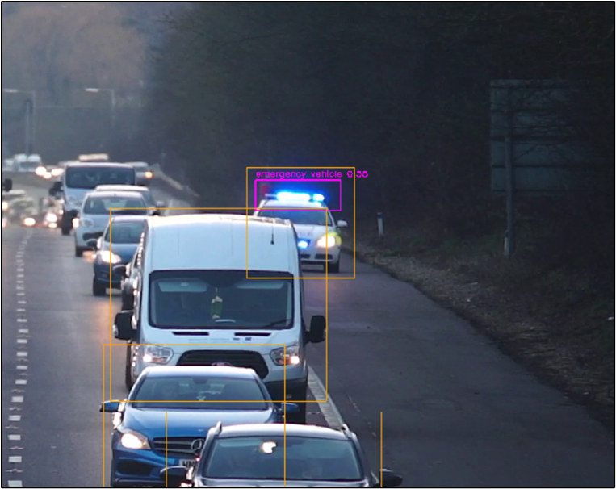
7. Implementation
02nd INTERNATIONAL CONFERENCE ON INTEGRATION OF COMPUTATIONAL INTELLIGENT SYSTEMS (ICICIS 2025)

Slide 10
8. Results
1. Improved Traffic Flow Efficiency : The system successfully reduced average waiting time for vehicles at intersections by prioritizing directions with higher vehicle counts.
2. Real-Time Adaptability : The system dynamically adjusted signal timings based on real-time vehicle counts, preventing unnecessary delays for less congested directions.
3. Fair Signal Distribution : Each direction received a minimum green light duration of 5 seconds, ensuring fairness while maintaining traffic flow.
4. Reduction in Idle Time : By dynamically adjusting green light duration, idle time for vehicles at intersections was significantly reduced.
5. Traffic Management Insights : Data collected on vehicle counts during the project provided valuable insights into peak traffic hours and patterns.
6. Scalability and Applicability : The system proved scalable for urban intersections and can be expanded to manage more complex traffic scenarios, such as multi-lane or high-speed intersections.
02nd INTERNATIONAL CONFERENCE ON INTEGRATION OF COMPUTATIONAL INTELLIGENT SYSTEMS (ICICIS 2025)

Slide 11
9. Conclusion
• Traffic Optimization: This adaptive traffic light control system reduces congestion, optimizes traffic flow, and ensures efficient use of green light time.
• Dynamic Control: By integrating real-time vehicle detection and using an intelligent algorithm, the system is capable of adjusting to changing traffic conditions.
• Real-time Monitoring: The system provides continuous monitoring of traffic conditions, improving overall traffic management at intersections.
02nd INTERNATIONAL CONFERENCE ON INTEGRATION OF COMPUTATIONAL INTELLIGENT SYSTEMS (ICICIS 2025)

Slide 12
Thank You!!
Arnav Sohani, Ishan Gaikwad, Omkar Lonkar, Samiksha Roy
Mobile No: +91 9373887699
Mail ID: lonkaromkar15@gmail.com
02nd INTERNATIONAL CONFERENCE ON INTEGRATION OF COMPUTATIONAL INTELLIGENT SYSTEMS (ICICIS 2025)

